Slide 1
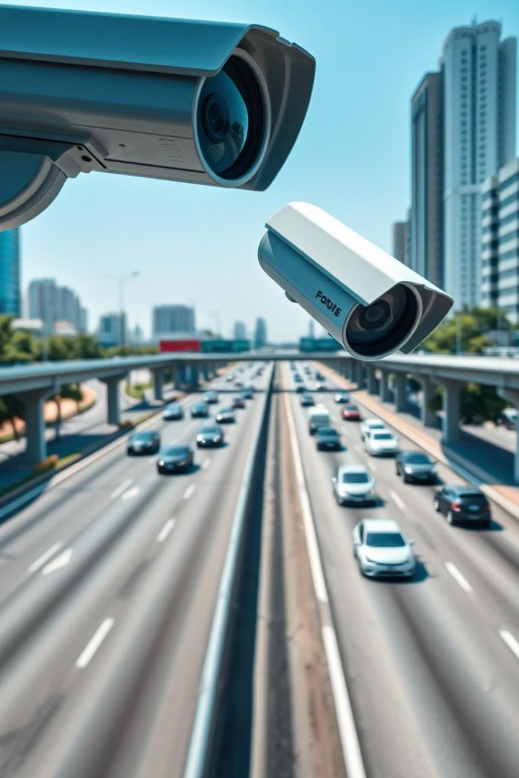
Vehicle Detection using HOG and SVM
Classical machine learning project leveraging OpenCV for traffic monitoring.

Slide 2
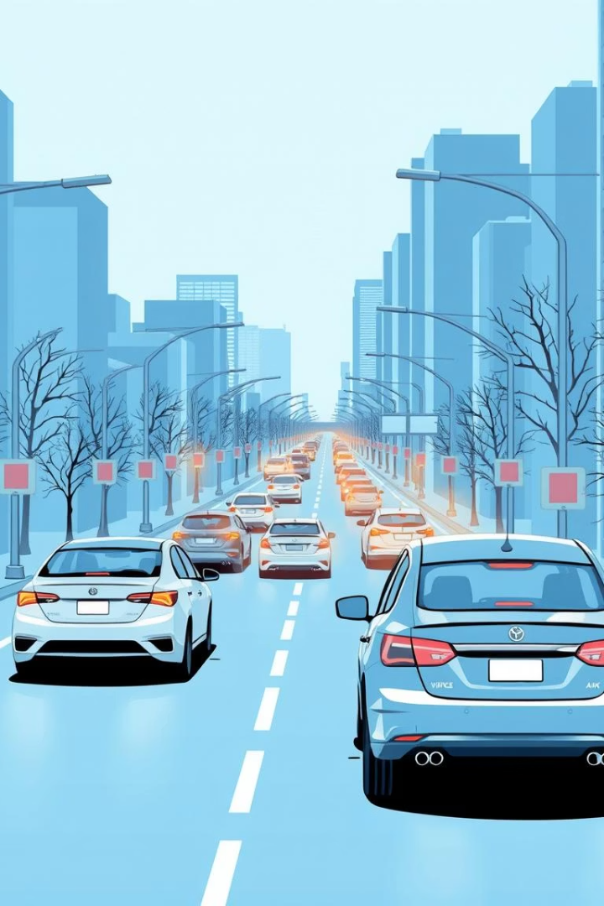
Overview of Vehicle Detection
Definition
Importance
Identifying vehicles in images and videos
Traffic control, smart city applications
Goal
Detect vehicles without deep learning

Slide 3

Technologies and Tools
Python
OpenCV
NumPy
SVM
HOG

Slide 4
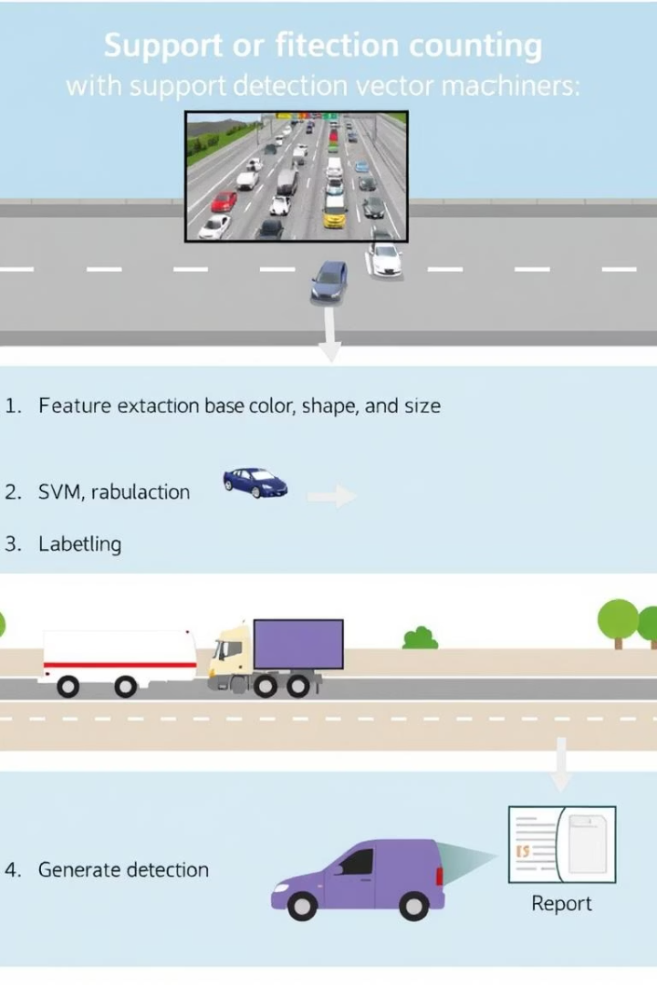




Project Workflow Pipeline
Video/Input Image
HOG Feature Extraction
SVM Training
Vehicle Detection & Counting

Slide 5
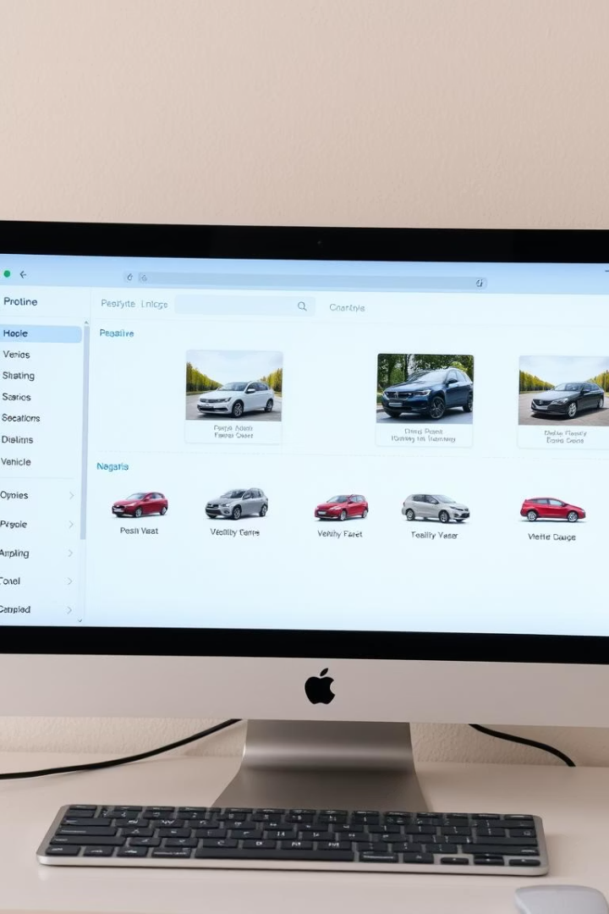
Training Dataset Options
Image Datasets
Video Frame Extraction
Positive and negative samples
Automatic frame saving for training
File Naming
Unique names prevent duplicates

Slide 6
Feature Extraction with HOG
Edge and Gradient Capture
Vector Representation
Detects shapes and textures
Converts images to features

Slide 7
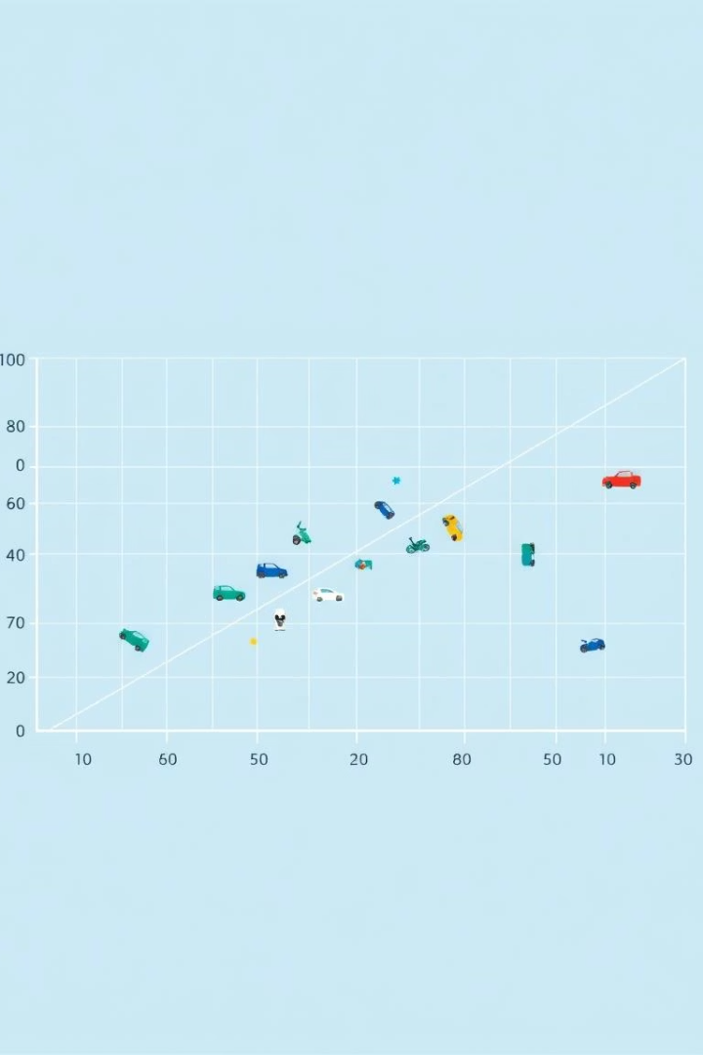
SVM Model Training
1
Linear SVM
2
Training
Simple yet effective classifier
Uses HOG features and labels
3
Model Storage
Saved as vehicle_detector.yml

Slide 8
Vehicle Detection Process
Detection API
Custom SVM Detector
Traffic Filtering
cv2.HOGDescriptor.detectMultiScale()
Applied for classification
Optional direction filtering

Slide 9

Summary & Next Steps
Future Work
Optimization
Integrate deep learning models
Review Results
Tune HOG and SVM parameters
Evaluate detection accuracy

Slide 10
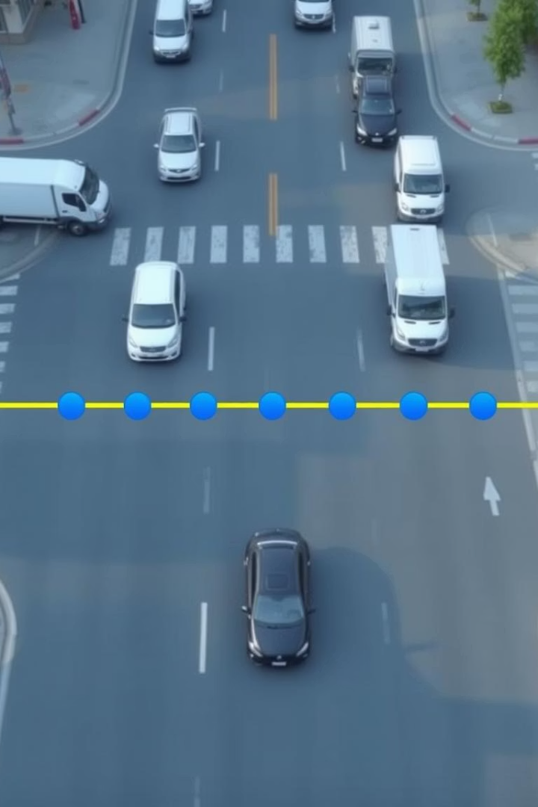
Vehicle Counting Mechanism
Counting Line
Crossing Detection
Drawn across video frame
Increment count when crossed
Live Feedback
Count displayed on frames

